Slide 1
Network Devices, MAC & ARP
Presenter: Nguyen Manh Hung
Date: 06/11/2026
Embedded Trainees

Slide 2

OVERVIEW
1
2
3
Network devices
MAC Address
ARP Protocol
hub, repeater
bridge, switch
router
gateway
firewall
MAC Denifition, Purpose
MAC Types
MAC Address Table
ARP Definition
How ARP works
ARP Packet Structure
ARP Table
1/19

Slide 3
01
HARDWARE
Network devices
Physical infrastructure provides the foundation for all network traffic.
1.1 Problem
1.2 Why use `while` instead of `if`?
2/19

Slide 4
1. Network devices
3/19

Slide 5
02
ADDRESSING
2. MAC Address
Physical addresses ensure hardware-specific identification on the local network.
8/19

Slide 6
2. MAC Address
10/19

Slide 7
03
3.1 Four Conditions for Deadlock
PROTOCOLS
3. ARP Protocol
3.2 Prevent Deadlock
ARP is the translation layer required to bridge IP logical addresses to hardware physical addresses.
3.3 Prevent Deadlock
3.4 Detect Deadlock
12/19

Slide 8
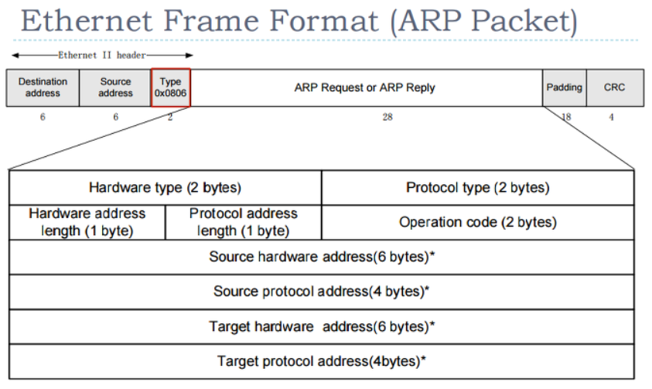
3. ARP Protocol
13/19

Slide 9
Thank you for listening...
Embedded Trainees

